Slide 1
Opioid Epidemic: Reducing Illicit and Prescription
Opioid Overdoses in Colorado
Team 4
Bridget Balkaran, MPH candidate 2018 | Biostatistics
Alexandra Gallegos, BS candidate 2017 | Public Health
Diana Ir, MPH candidate 2018 | Public Health
Nicholas Tomlinson, PharmD candidate 2020
Notes:
Diana

Slide 2
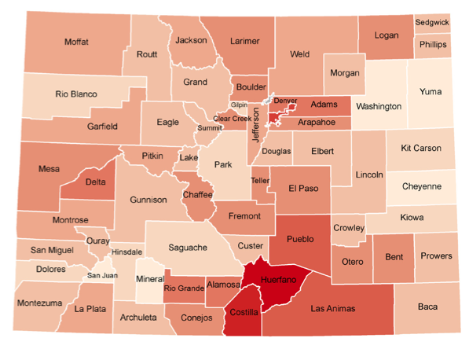
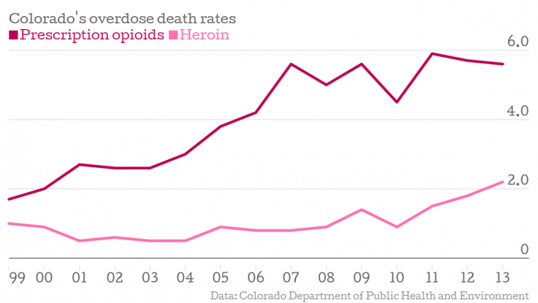
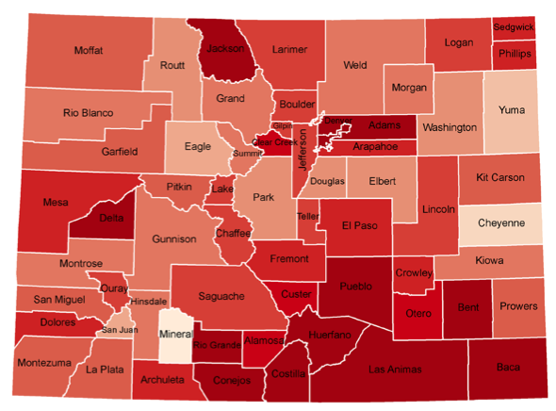

Prescription Opioid Overdoses in Colorado
CO ranks 2nd in nation for opioid abuse
Colorado overdoses 2000-2015
Total drug overdose deaths: 10,544
Opioid-related deaths: 3,537
Denver overdoses 2009 – 2016
Total drug overdose deaths: 1,203
Colorado Counties: Highest overdose death rates: 2002
Pictured are the rates of overdose death per 100,000 people in Colorado.
Colorado Counties: Highest overdose death rates: 2014
Notes:
Diana - slide 2
Why does drug overdosing matter?
Colorado ranks 2nd in the nation for opioid abuse
The CDC did a study on high overdose rates in Colorado counties in 2002-2014
dark = higher death that there
This brings in the questions, where are these drug related deaths coming from?
This graph from CDPHE, shows [read slides] from 1999 to 2013.
As you can see, Presc opioids represented by the dark pink and heroin shown by light pink both had increased trends of rate of abuse, with higher mortality associated with abuse of prescription opioids as compared to heroin

Slide 3

Objective
Goal
Develop an innovative solution to bring awareness of the issue and formulate strategies to reduce prescription opioid overdoses in Colorado
Implement a multidisciplinary approach to managing prescription opioid abuse through reduction of prescriptions and improved management of individuals with a history of opioid abuse
Notes:
Diana
What are we trying to do? What will we do?
Read slides

Slide 4
Project Aims...
Mobile Pain Management Clinics (MPMC) County: Denver-Metro Area (high prevalence of drug overdose) Population of Interest: Chronic Pain Sufferers with Lower Back Pain (LBP) in low income populations - >50% of prescription of opioids are patients w/ LBP (Deyo et al 2009) - patients with medicaid are associated with increased use of opioid Partnership: Denver Health - Denver region and consists of low income populations
3-year plan outline: Year 1: Mobile Clinic in Denver-metro area Year 2: Project Echo with PCPs Year 3: Patients with severe pain referred from PCP
Notes:
Diana
Establish a team of of mobile pain management specialists in read slides

Slide 5
Year 1: Patient Through Denver Health ER (Problem)
Patient
Denver Health ER
Skip follow up
Pain not adequately managed
Rx
Patient
Discharged
Patient goes back to ER for treatment
Notes:
Diana Here is a scenario of a problem
Patient goes to the ER, ER doctor gives them temp relief and asked patient to do followups with a PCP, patient gets discharge.
Patient misses follow-ups
So patients pain recurs and pain is not managed, so they return to the ER for treatment. Cycle repeats, we get higher readmittance rates and less effective management of pain

Slide 6

Year 1: Mobile Clinic in Denver Metro Area - Pain Management Consultation Appointment Agenda (Solution)
Team specialists: Pain specialist with MD, physical therapist, nurse, psychologist, *OBGYN, *occupational therapist
Collect patient medical history/assessments
Exam and Diagnosis
Alternative therapies of pain management
Treatments if person shows symptoms of abuse
Teach Back
Additional information
*consult via secure HIPAA compliant video conferencing off-site to reduce expenditures
Notes:
Diana
We plan to establish a mobile pain management specialist’s team consisting of medical doctors such as pain specialists, physical therapists, nurses, and psychologists as well as specialized population healthcare professionals such as OBGYN if there are pregant woman who need pain management treatment or occupational health therapists.
Our specialists team will follow a protocol for patient consultation in pain management which consists of the normal patient information collection medical history, followed by health literacy and depression assessments, in which these assessments will help us diagnose symptoms of abuse.
If they certainly are showing signs of abuse, we provide them alternative forms of pain management
A way to understands the doctor’s recommendations for pain management is through teach back - confirmation of patient understand doctor’s recommendation on how to manage pain
Additional information - provide supplemental information for patients in pain management - e.g low impact exercises, yoga
Newest vital assessment → determine health literacy
PHQ2/PHQ3 → depression behavioral assessment
Pain assessments →
If depressed, we bring in a psychology to help with mental health pain management because if they show signs of depression, its been studied mental health is associated abuse of opioids.

Slide 7
Year 1: Intervention Through Denver Health ER
INTERVENTION: Pain Management Consultation Appointment Agenda
Patient
Patient
Discharged
Travel to patient
Follow up with MPMC
Denver Health ER
Patient goes back to ER for treatment
Target population #: 1000
Notes:
Diana
However, with our intervention…
The patient goes to the ER, ER doctor consults with our specialized Pain Management Team at Denver Health
The pain management team will then treat the patient, patient gets discharged
Pain management team will travel to the patient for follow-up to supplement standard care which will then reduce near term hospital readmissions

Slide 8

Year 1: Alternative forms of management
OTC drugs/topicals
Acupuncture, partner with AAC (Acupuncture Association of Colorado).
Decreases pain by 75% and ⅔ chronic pain patients are willing to try it.
Gabapentin or Pregabalin
FDA approved, serious adverse side effects rare
Osteopathic manipulation (spinal manipulation practices)
Hypnotherapy- (mental) reduces anxiety associated with pain
Cognitive Behavior Therapy
GOAL: Reduce amount of Opioids prescribed.
Notes:
Nick-
OTC products- Acetaminophen, NSAIDS, capsaicin
Acupuncture- decrease pain by 75% and two-thirds chronic pain pts are willing to try
Gabapentin and Pregabalin- Binds to alpha₂-delta subunit of voltage-gated calcium channels within the CNS and modulates calcium influx at the nerve terminals, thereby inhibiting excitatory neurotransmitter release
Hypnotherapy- Medical research has made it an alternative therapy as its converted chronic pain to acute, (the connection between mind and body)

Slide 9
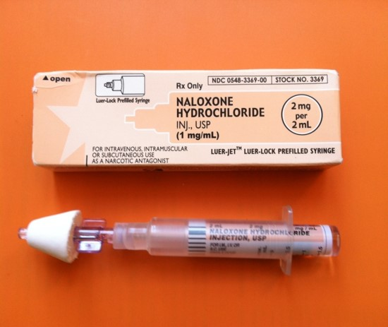
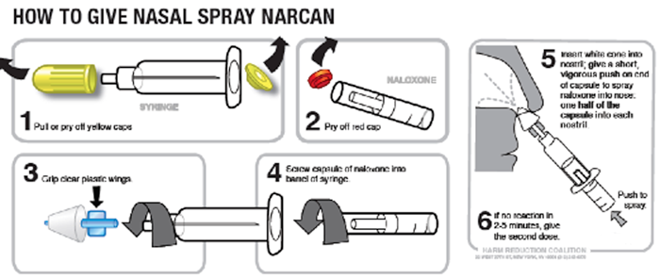
Opioid Overdose Prevention Strategies
Naloxone (Narcan) Rx w/ every Opioid Rx (Naloxone is covered by Medicaid in CO)
Teaching family members how to use nasal naloxone (YEAR 1)
Mandatory use of PDMP by doctors and pharmacists (like NY)
Teaching PCPs and pharmacists to use regularly (YEAR 2)
Mandatory counseling by pharmacists (like CA, AZ)
Notes:
Nick
Naloxone- Opioid Antagonist
So we are going to lobby for Naloxone Rx w/ every
In 2014, according to a Johns Hopkins Public Health survey, only about half PCPs used the Prescription Drug Monitoring Program
In 2013, in Colorado, only 31 percent of healthcare providers w/ Rx authority and pharmacists had a PDMP account
In 2015, in Colorado, 92 percent had a PDMP account b/c it is mandatory by law to have accounts, but not mandatory to use it.
Counseling of patients by pharmacists is not required in Colorado.

Slide 10

Year 2: Project Extension for Community Health Outcomes (ECHO)
Project ECHO for PCP: Pain Management
Patient
Patient does not return for follow up
PCP
Rx
OP pain management
Pain not adequately managed
Patient returns to PCP after follow up period with chronic pain
Notes:
So in this schematic Without Project Echo the PCP recommends pain management (possibly a Rx for an opioid) but the patient does not follow-up, and could be abusing opioid medication. So the pt could come back to PCP or another PCP for more opioid tx.

Slide 11
Year 2: Project ECHO
PCP manage pain
with Pain Management Consultation Appointment Agenda
Project ECHO for PCP: Pain Management
Patient
INTERVENTION: Project ECHO training for pain management
PCP
OP pain management
Effective pain management
Aim: 30 PCPs in year 2
Patient returns to PCP after follow up period with chronic pain
Notes:
Nick
With Project Echo we will teach PCPs Alternative medications, use of PDMP, Rx naloxone with opioid RX, better follow-up measures and creating effective pain management without the risks of opioid abuse.
2 cohorts of project echo
1 cohort = 15 PCPs

Slide 12


Year 2: Project ECHO
Partnership with Extension for Community Health Outcomes (ECHO) in Colorado
Professional education initiative aimed at connecting health workforces to topic experts to increase access to specialty care and expert knowledge
Trains primary care physicians via video conference on pain management -> deliver services normally reserved for specialist.
Improves care and reduces healthcare spendings, while boosting clinician’s job satisfaction
Aims to keep patients under the care of PCP, rather than having them refer to specialists - an increasingly common practice that can expose them to inconsistent care and unnecessary tests
Restructure Pain Management Certificate Program (Include patient education and a psychological assessment)
Notes:
Nick
As I said before, Our specialized Pain Management Team will partner with Project ECHO who offers webinar education to PCP
Read slides…

Slide 13
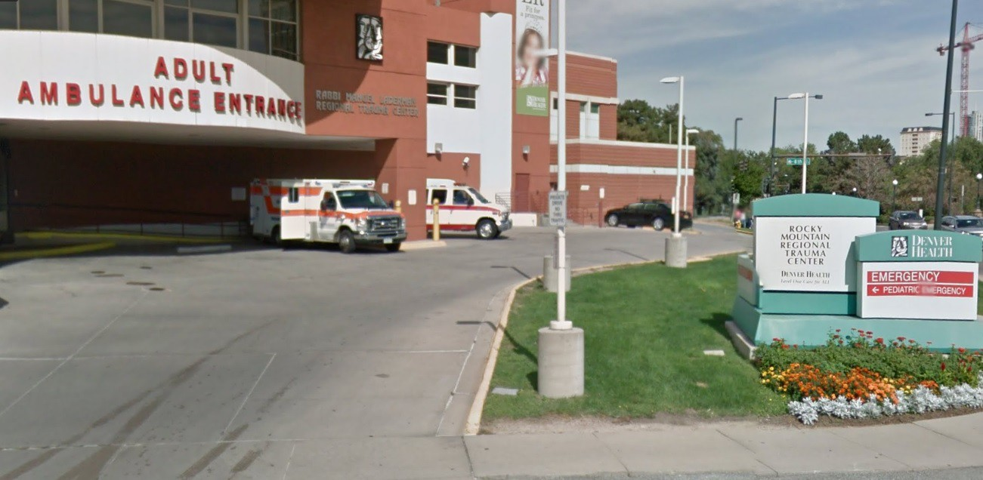
Year 3: Referral for PCP
Pain management for more serious cases
If PCP cannot adequately manage case or patient needs more attention → MPMC will be called in.
Notes:
Nick
So in year 3 in addition to working with Denver Health ER patients, we will provide a service to the PCP to refer patients who are not being adequately managed to the mobile pain management

Slide 14
Year 3: Referral for PCP’s More Serious Cases
Patient
INTERVENTION: Pain Management Consultation Appointment Agenda
Patient does not return for follow up
PCP
OP Pain management
Pain not adequately managed
Pain not adequately managed with OP pain management techniques
Notes:
Nick

Slide 15
Year 3: Referral for PCP’s More Serious Cases
Patient
INTERVENTION: Pain Management Consultation Appointment Agenda
INTERVENTION: Referral to MPMC
Individualized treatment plan and follow up for patients with more severe pain
PCP
OP Pain management
Pain not adequately managed with OP pain management techniques
Notes:
Nick

Slide 16
Plan Summary for Outreach
Year 1 : Apply Intervention
Year 2: PCP Education
Year 3: Referral through PCP
PCP
Patient
PCP
Patient
MPMC/ Denver Health
ER
PCP
MPMC/ Denver Health
MPMC / Denver Health
PCP
Patient
Patient
Patient
PCP
Patient
Patient
Notes:
Diana
Year 1: Treat patients with chronic lower back pain that come in through Denver Health, get to patient
Year 2: Work with Project Echo on outreach and education for PCP in pain management, get to PCP
Year 3: Act as referral service for PCP whose chronic pain patients need extra attention or follow up, get to serious cases through referral
A way to increase our outreach

Slide 17
Budget: Year 1
Category | Cost
Specialty Pain Management Team | 750,000
Transportation and Associated Costs | 85,000
Other Medical and Non-medical Costs | 100,000
Operational Costs | 80,000
Total | 985,540
Notes:
Nick
Speciality Team- $750,000 - $850,000/ yr.
Transportation- $82,000 (year 1) $50,000 (years 2 & 3)
Customized Vehicle, Driver and Insurance.
Partnership with Acupuncture Association of Colorado- $450/ year
Additional (Other medical & non medical services)- $5,000/ year
Ex: technology, additional therapy treatments,
Operation costs
communication , and te

Slide 18
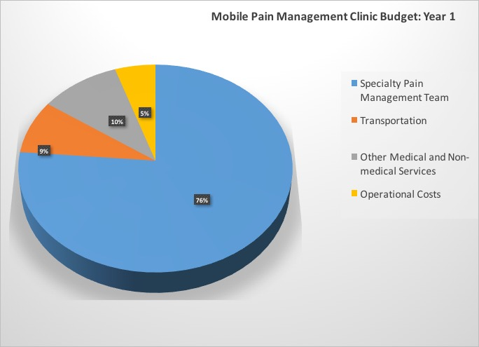
Budget

Slide 19
Budget: Years 2 and 3
Category | Cost
Specialty Pain Management Team | 1,700,000
Transportation and associated Costs | 100,000
Other Medical and Non-medical Costs | 70,000
Operational Costs | 80,000
Project Echo | 60,000
Total | 2,010,000
Notes:
Additional costs in years 2 and 3 consist of Partnering w/ project echo and we save costs in operational and med/nonmed start-up fees from year 1

Slide 20
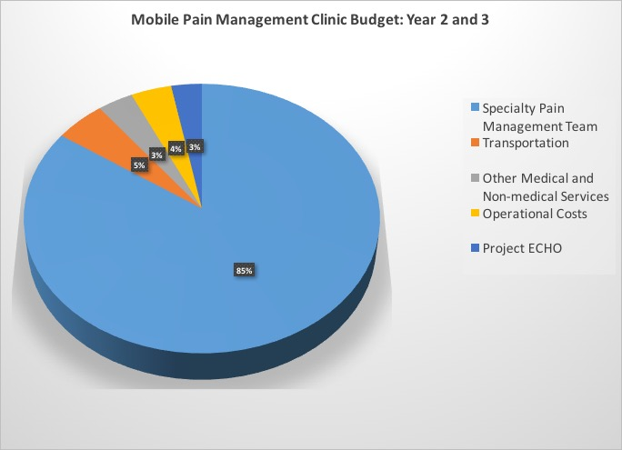
Budget
Notes:
Other medical and non-medical, and operational costs are less in years 2 and 3 due to no start-up fees

Slide 21
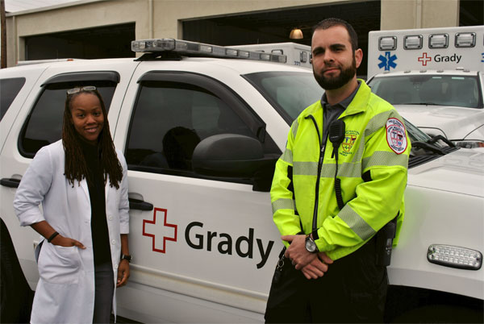
Summary
Our Proposal will:
Decrease the amount of opioids being prescribed
Decrease opioid overdoses
Establish better follow-ups
Be sustainable
Decrease costs for Denver Health emergency department
Notes:
Nick-
To validate our proposal, in 2013, in Altanta, Grady EMS, a department of Grady Memorial Health, established a mental health mobile crisis unit to decrease the time and money that EMS and the emergency department were spending. Overall over 400,000 dollars were saved between EMS and the Emergency Department.

Slide 22
References:
Acupuncture Association of Colorado. Retrieved November 12, 2016, from http://acucol.com/http/acucol.com/acupuncturists-area
Centers for Medicare and Medicaid Services. Federally Qualified Health Centers. Retrieved November 12, 2016, from https://www.cms.gov/Center/Provider-Type/Federally-Qualified-Health-Centers-FQHC-Center.html
Daley, J. (2016, February 16). Colorado drug overdoses up in almost every county and ahead of national average. Retrieved November 12, 2016, from http://www.cpr.org/news/story/colorado-drug-overdoses-almost-every-county-and-ahead-national-average
Denver Health. (2016). Retrieved November 12, 2016, from http://www.denverhealth.org
Hahn, K. L. (2011). Strategies to prevent Opioid misuse, abuse, and diversion that may also reduce the associated costs. American Health and Drug Benefits, 4(2), 107–114. Retrieved from https://www.ncbi.nlm.nih.gov/pmc/articles/PMC4106581/
Longo, D. L., Volkow, N. D., & McLellan, A. T. (2016). Opioid abuse in chronic pain — misconceptions and mitigation strategies. New England Journal of Medicine, 374(13), 1253–1263. doi:10.1056/nejmra1507771
Mobile health Apps interactive tool. (2016, April 4). Retrieved November 12, 2016, from https://www.ftc.gov/tips-advice/business-center/guidance/mobile-health-apps-interactive-tool
Pain Management Center (2016). Pain management center. Retrieved November 12, 2016, from https://stanfordhealthcare.org/medical-clinics/pain-management.html
Pfizer. (2002). Newest Vital Sign Toolkit. Retrieved November 12, 2016, from Pfizer, http://www.pfizer.com/health/literacy/public_policy_researchers/nvs_toolkit
Project ECHO Colorado. (2015, September 26). Retrieved November 12, 2016, from https://echocolorado.org/partners-2/

Slide 23
References Continued
Rowbotham, M. C. (2012). What alternatives are there to the use of opioid analgesics in the treatment of chronic pain in light of existing evidence and its limitations? Retrieved from http://www.fda.gov/downloads/drugs/newsevents/ucm307837.pdf
Stanaway, N. (2016, May 23). Community Paramedic Program Cuts Mental Health Patient Call Volume. Retrieved November 12, 2016, from EMS, https://www.ems1.com/community-paramedicine/articles/93357048-Community-paramedic-program-cuts-mental-health-patient-call-volume/
Stanos S. Focused review of interdisciplinary pain rehabilitation programs for chronic pain management. Curr Pain Headache Rep. 2012;16:147-152.
Strategies to Reduce Prescription Drug Abuse Lessons Learned from the ACAP SUD Collaborative. (2015). . Retrieved from http://www.communityplans.net/portals/0/fact%20sheets/ACAP_Substance_Use_Disorder_Toolkit.pdf
Sullivan, M. D., Edlund, M. J., Zhang, L., Unützer, J., & Wells, K. B. (2006). Association between mental health disorders, problem drug use, and regular prescription Opioid use. Archives of Internal Medicine, 166(19), 2087. doi:10.1001/archinte.166.19.2087
The Health Law Firm (2011, December ). Recent Changes to Florida’s Pain Management Laws 2011-2012. Retrieved November 12, 2016, from The Health Law Firm, http://www.thehealthlawfirm.com/resources/health-law-articles-and-documents/florida-pain-management-laws.html
Turk DC, Stanos SP, Palermo ™, et al. (2010). Interdisciplinary Pain Management, Glenview, IL: American Pain Society
Turk DC, Wilson HD, Cahana A. (2011) Treatment of chronic non-cancer pain. Lancet.

